Slide 1

Power BI
Dough mindset

Slide 2
Power BI
Data Collection
Data Transformation/Wrangling/preparation
Data Modeling
Data Analysis
Data Visualization

Slide 3
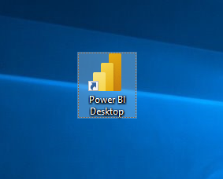
Power BI
Get data
Double click Power BI icon

Slide 4
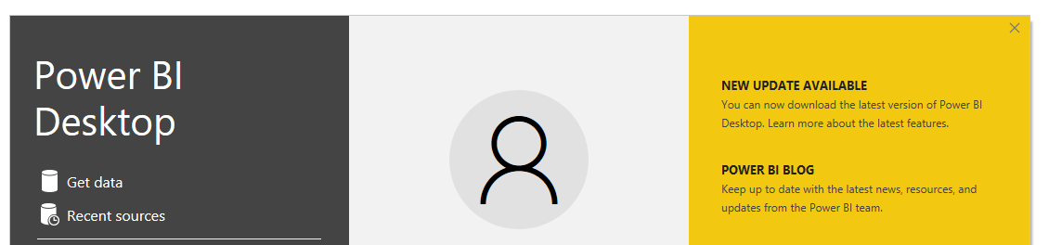
Power BI
Get data
Close the pop up window.

Slide 5
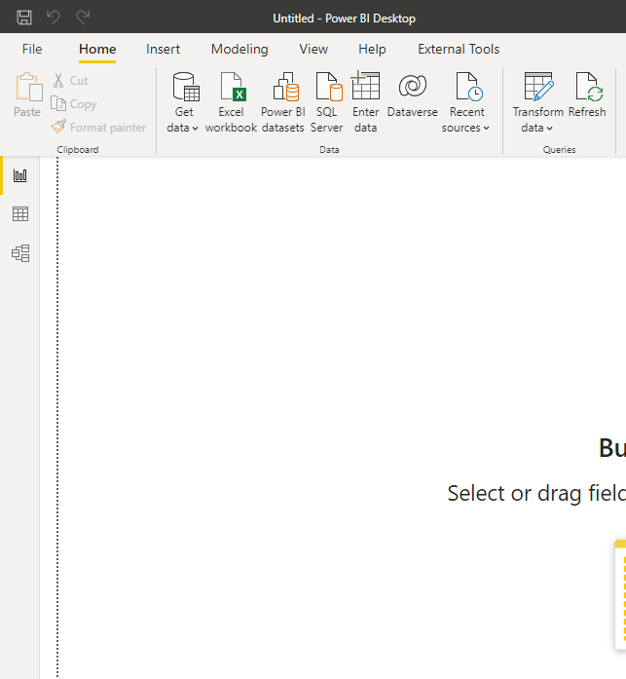
Power BI
Get data
Go to “File”

Slide 6
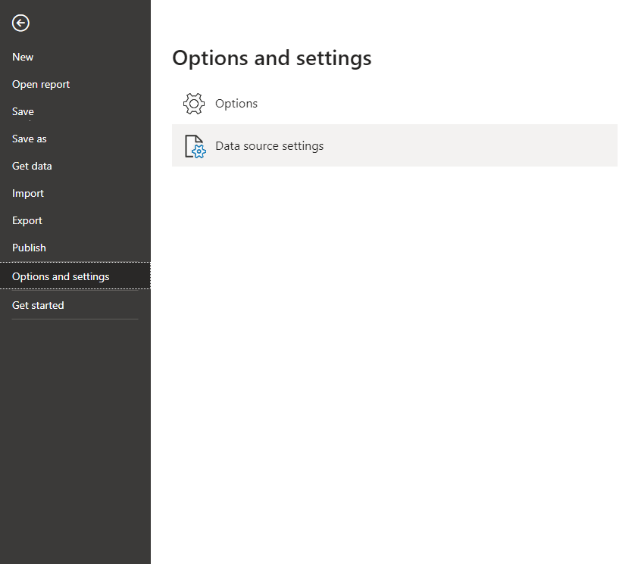
Power BI
Get data
Go to “Options and settings”
Then “Options”

Slide 7
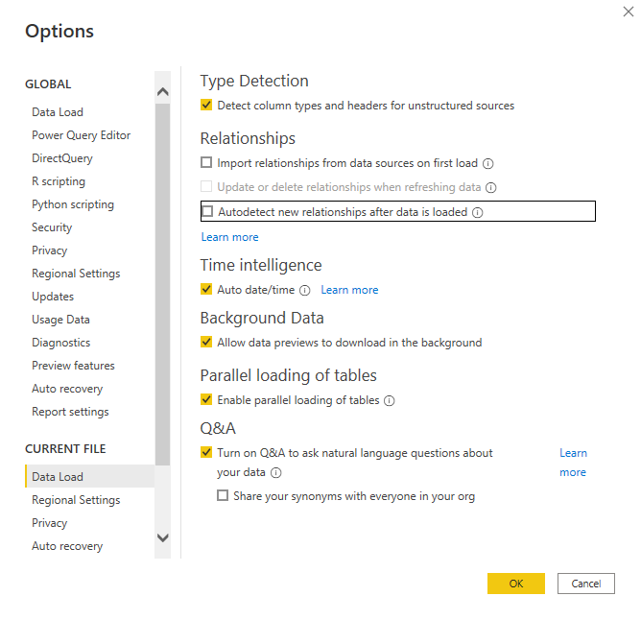
Power BI
Get data
Go to “Data Load”
Unselect the 2 options
Click “Ok”

Slide 8
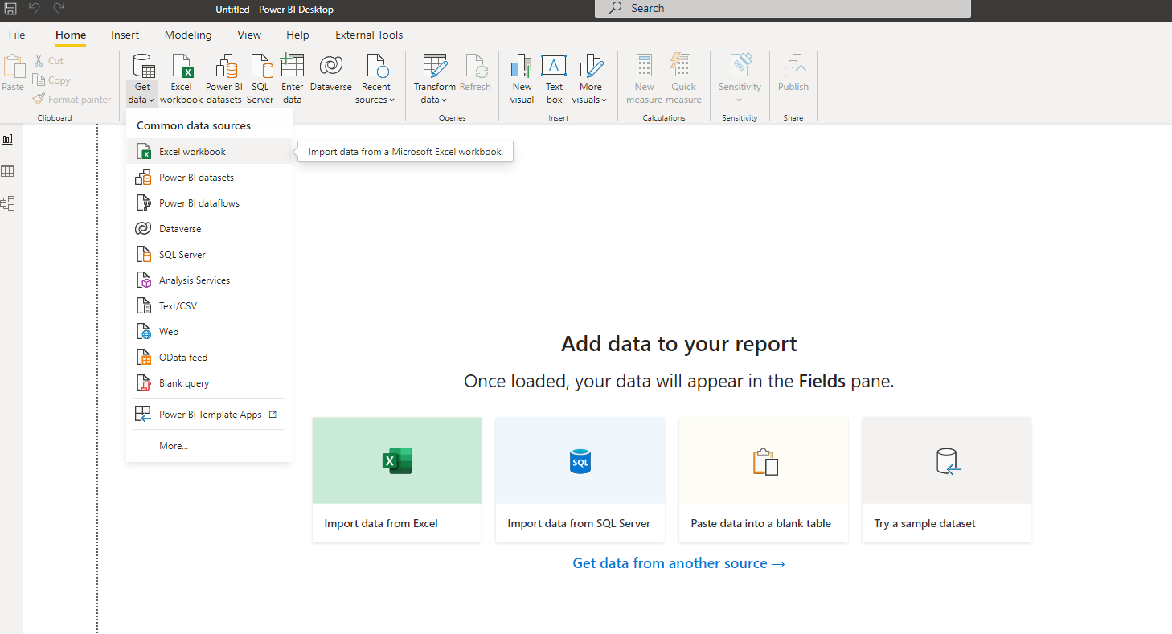
Power BI
Get data
Go to “Get data”
Then “Excel workbook”

Slide 9
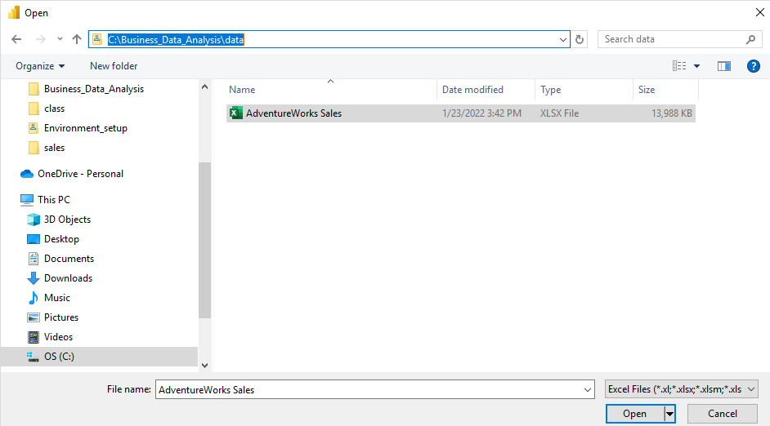
Power BI
Get data
Go to “C:\Business_Data_Analysis\data”
Select “AdventureWorks Sales”
Click “Open”

Slide 10
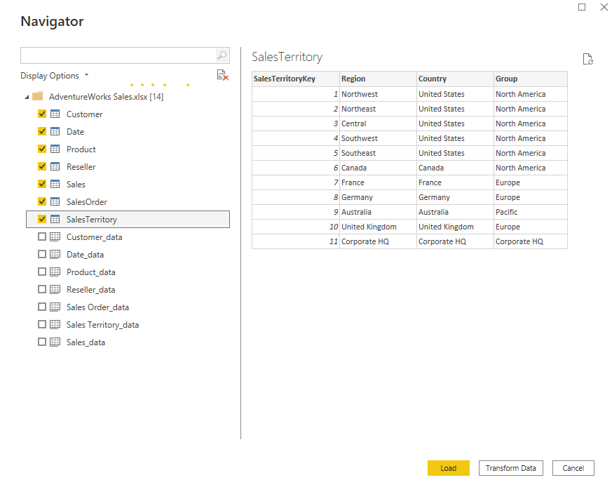
Power BI
Get data
Select the tables
Click “Transform Data”

Slide 11
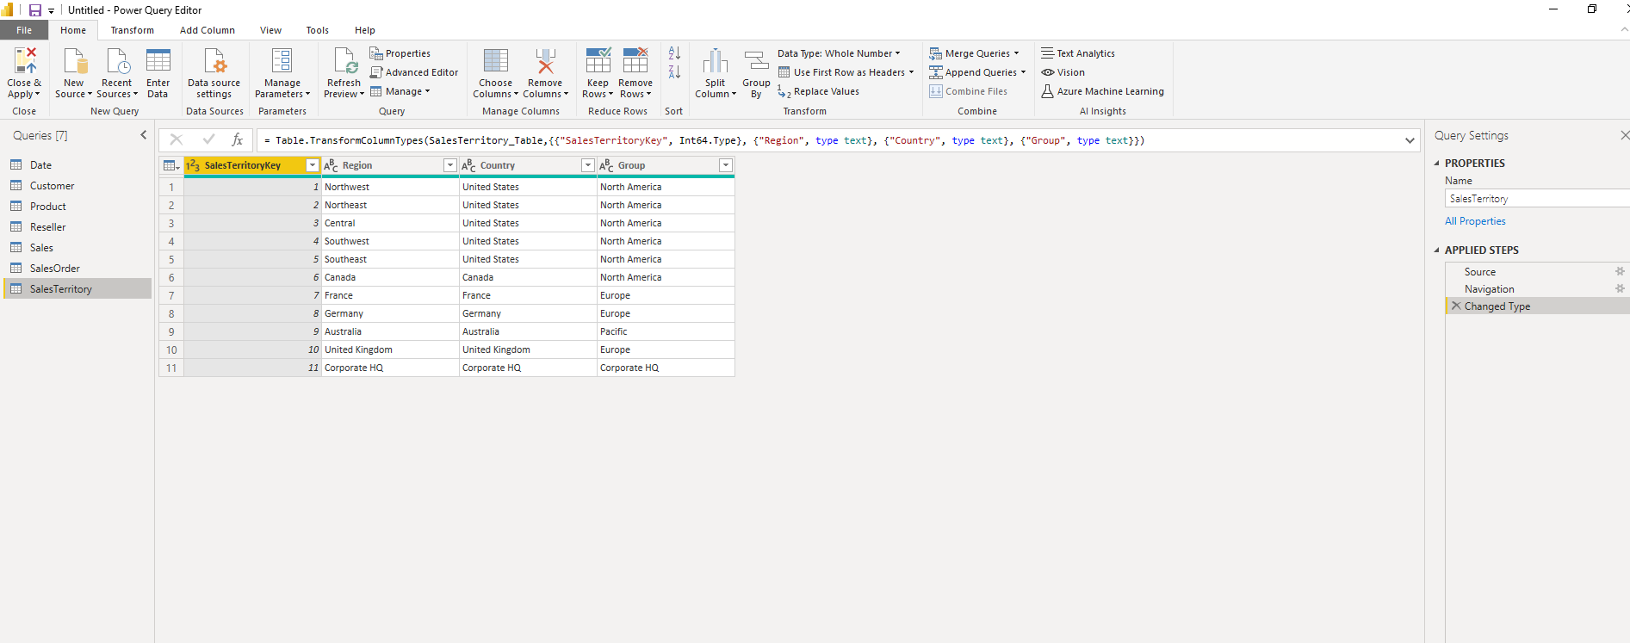
Power BI
Get data
Now we are at the Power Query Editor window

Slide 12
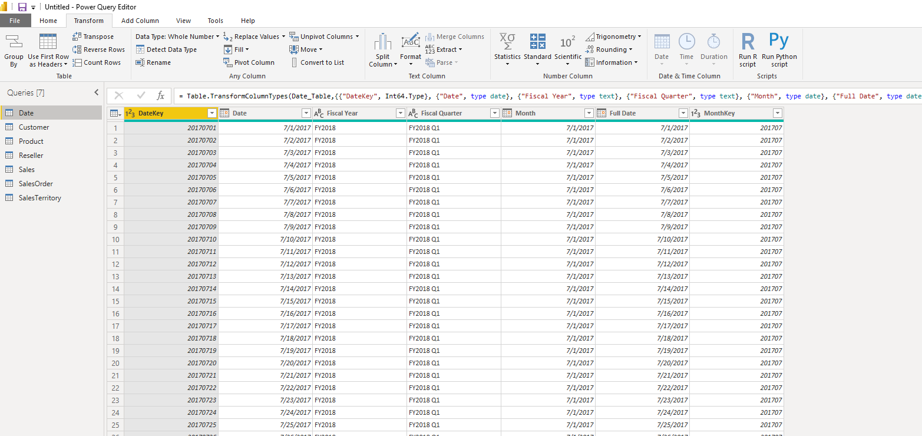
Power BI
Get data
Go to Transform
Click “Detect Data Type”

Slide 13
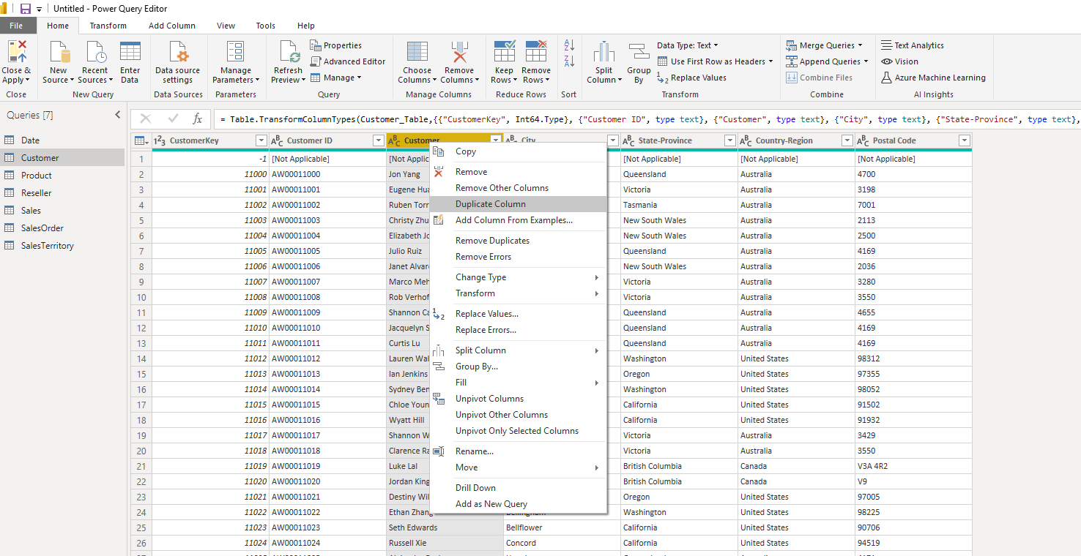
Power BI
prepare data
Go to Home
Select “Customer” table
Select “Customer” column
Right click “Customer” column
Select “Duplicate Column”

Slide 14
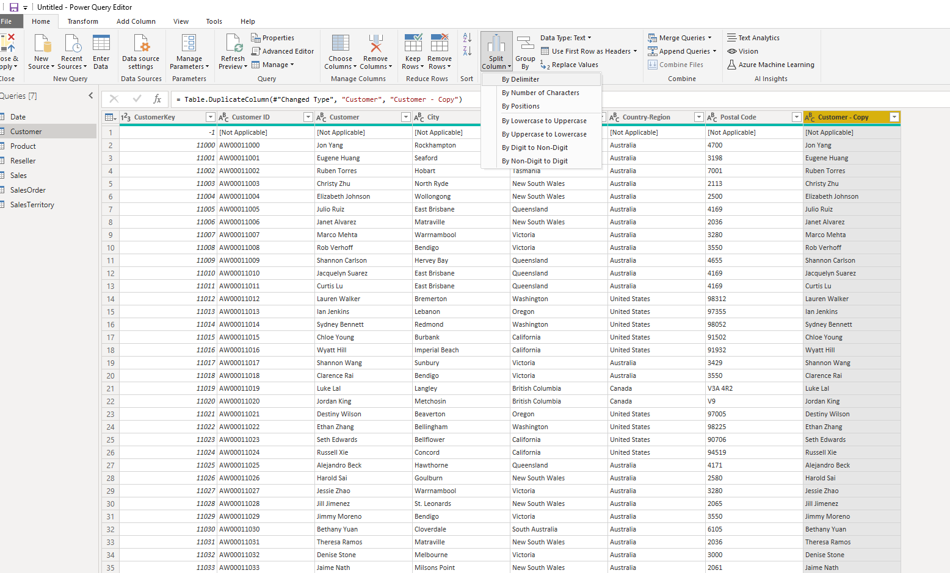
Power BI
prepare data
Select “Customer- Copy” column
Click “Split Column”

Slide 15
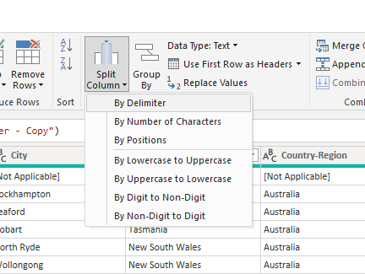
Power BI
prepare data
Select “By Delimiter”

Slide 16
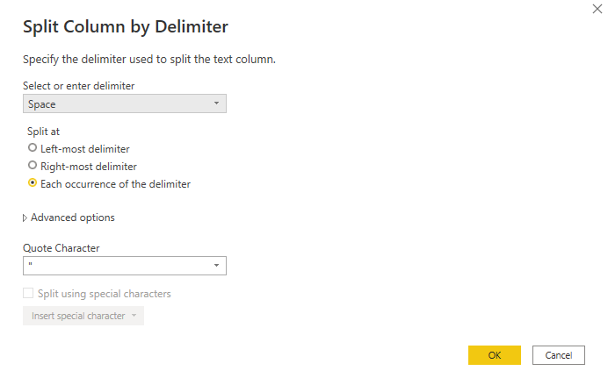
Power BI
prepare data
Select “Space”
Click “OK”

Slide 17
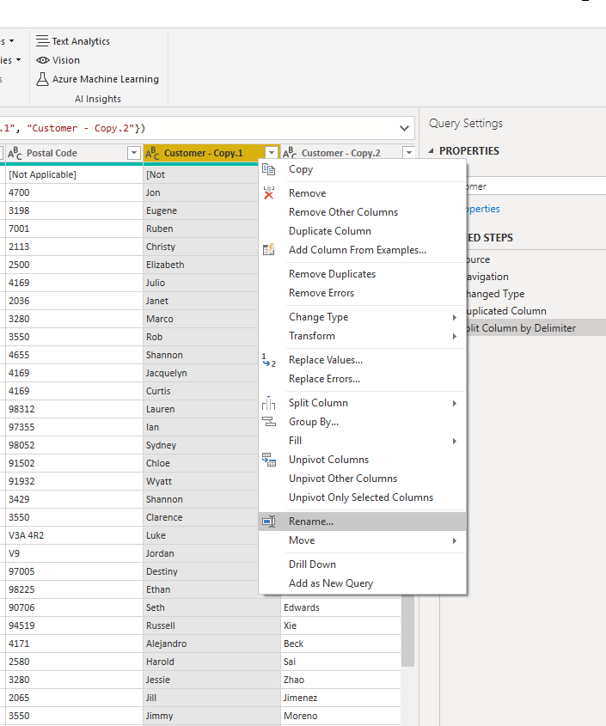
Power BI
prepare data
Right Click “Customer – Copy.1”
Select “Rename”

Slide 18
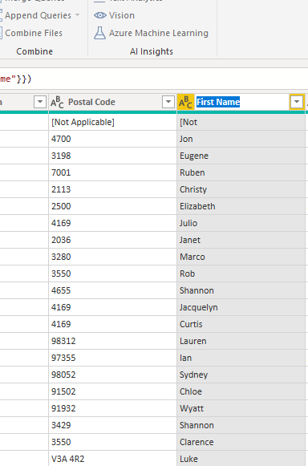
Power BI
prepare data
Type “First Name”

Slide 19
Power BI
prepare data
Right Click “Customer – Copy.2”
Select “Rename”

Slide 20
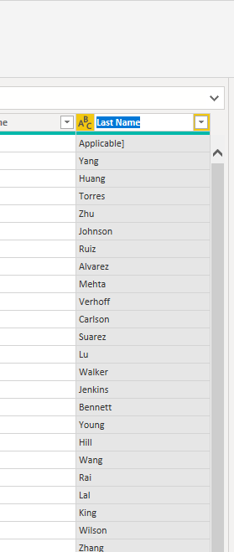
Power BI
prepare data
Type “Last Name”

Slide 21
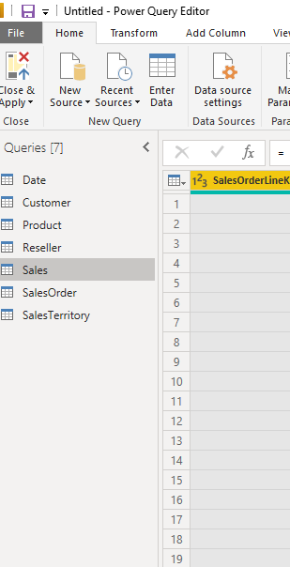
Power BI
prepare data
Click “Sales” table

Slide 22
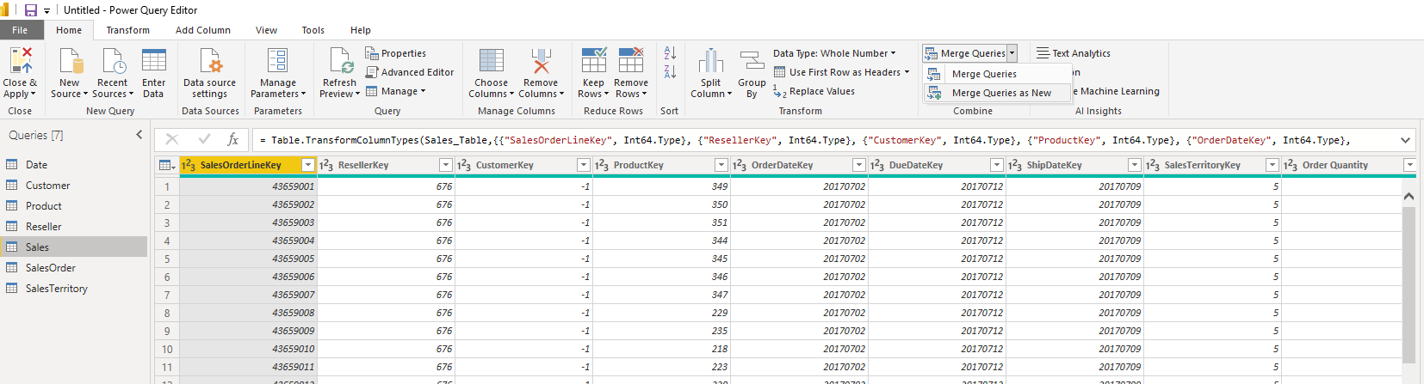
Power BI
prepare data
Click “Merge Queries” arrow(not “Merge Queries”)
And then “Merge Queries as New”

Slide 23
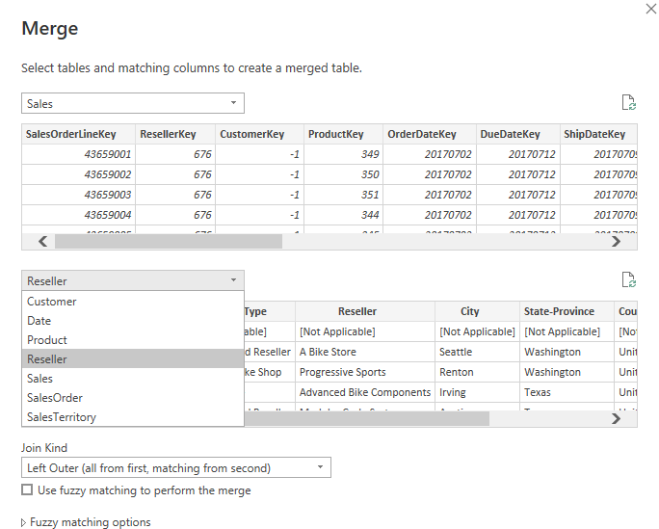
Power BI
prepare data
Select “Reseller”

Slide 24
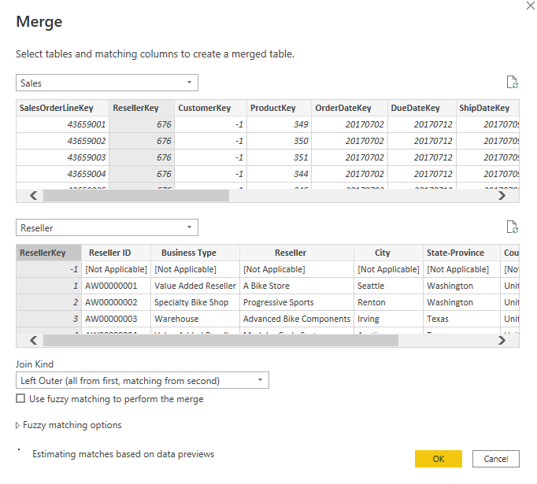
Power BI
prepare data
Select “ResellerKey” from “Sales” table
Select “ResellerKey” from “Reseller” table
Click “OK”

Slide 25
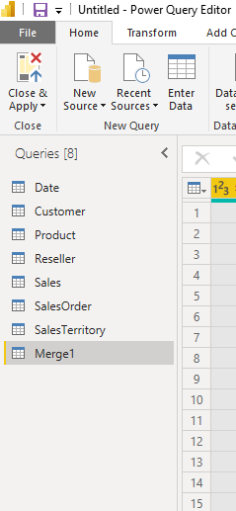
Power BI
prepare data
Right click “Merge 1”

Slide 26
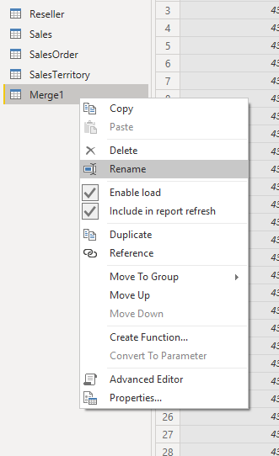
Power BI
prepare data
Select “Rename”
Type “Sales_Reseller”

Slide 27
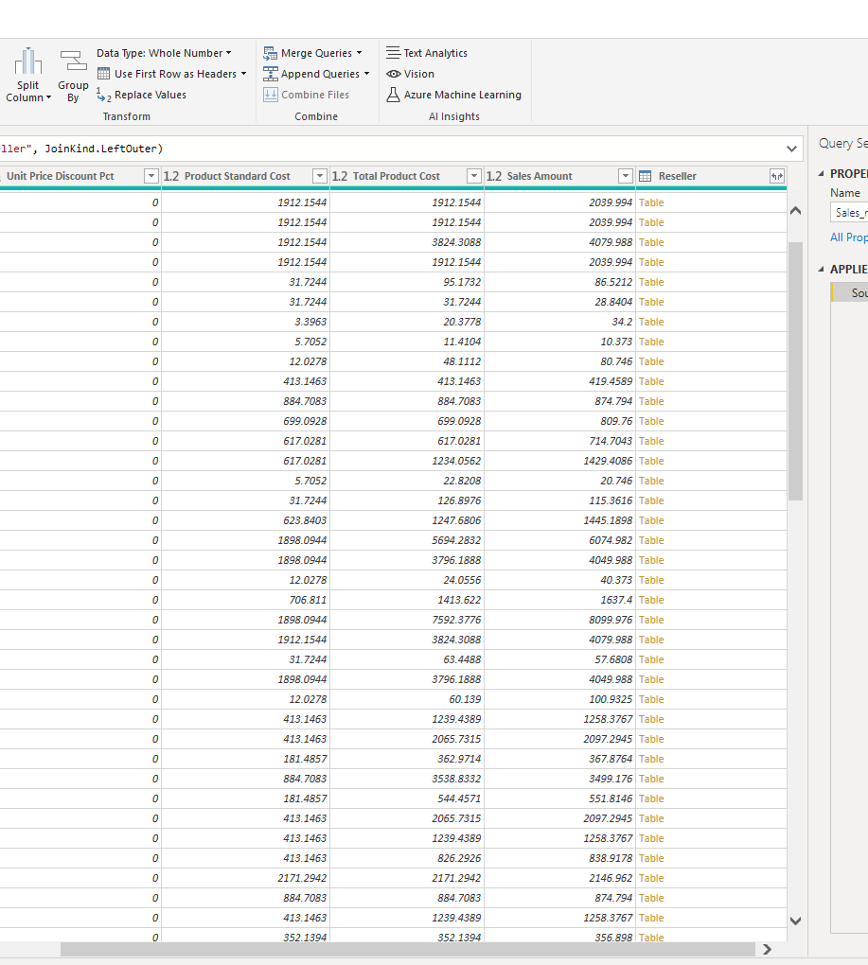
Power BI
prepare data
Scroll to the right end of the table
Find “Reseller”
Extend it

Slide 28
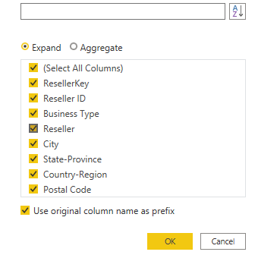
Power BI
prepare data
Click “OK”

Slide 29
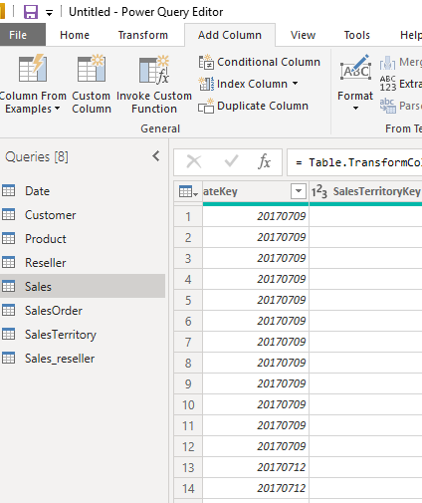
Power BI
prepare data
Select “Custom Column”

Slide 30
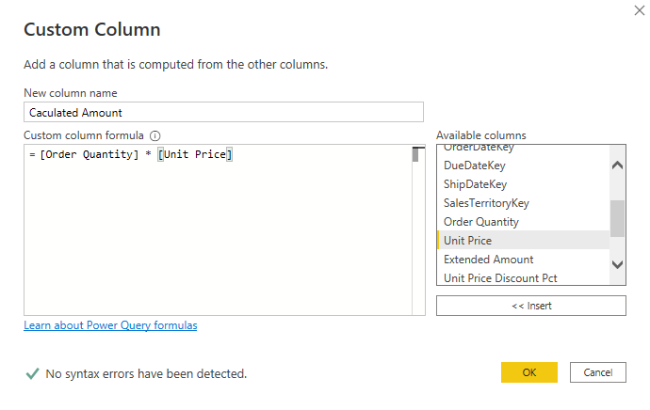
Power BI
prepare data
Name the new column “Calculated Amount”
Double Click “Order Quantity” and “Unit Price” to insert them into the formula.
Multiply them using “*”
Click “OK”

Slide 31
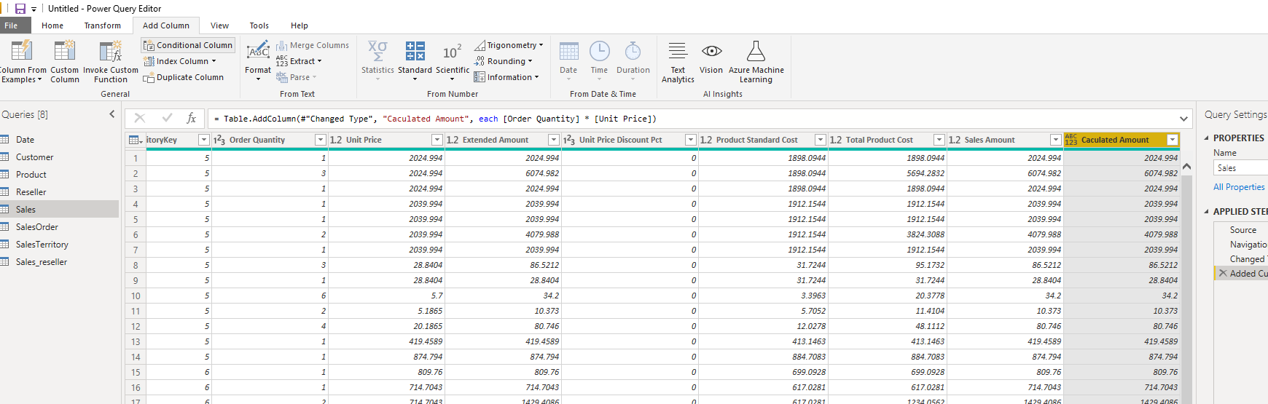
Power BI
prepare data
Click “Calculated Amount”
Select “Conditional Column”

Slide 32
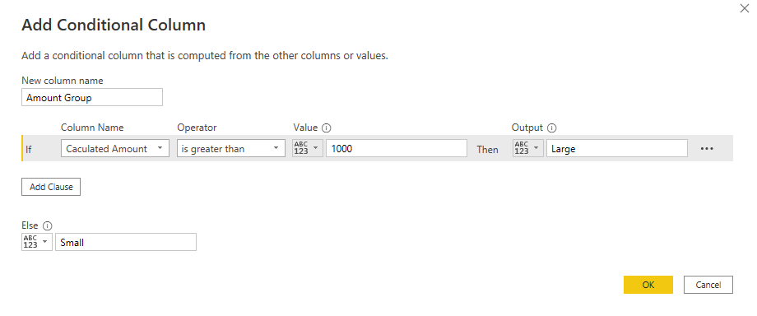
Power BI
prepare data
Fill out the form
Click “OK”

Slide 33
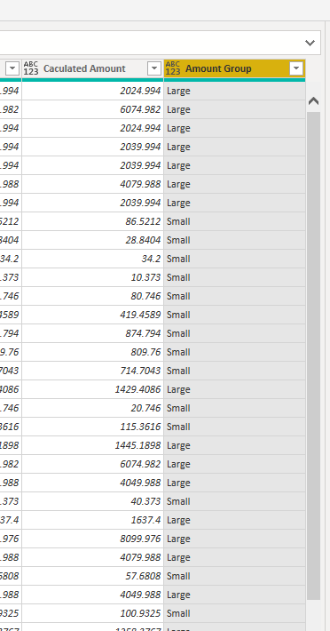
Power BI
prepare data
Now we have created 2 new columns

Slide 34
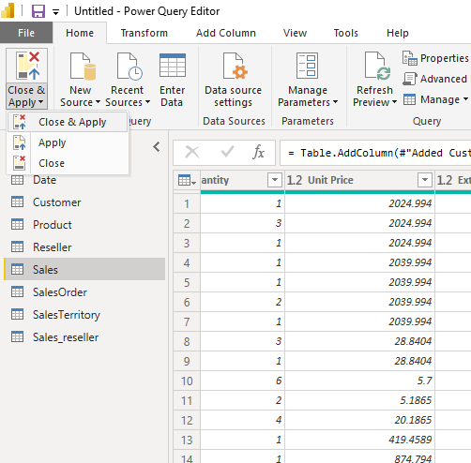
Power BI
prepare data
Go to “Home”
Click “Close & Apply”
Select “Close & Apply”

Slide 35
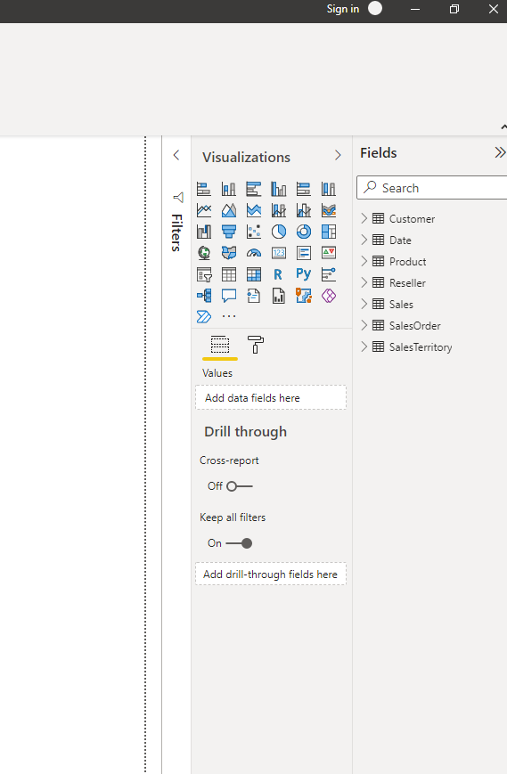
Power BI
Get data
You should see the tables on the right

Slide 36
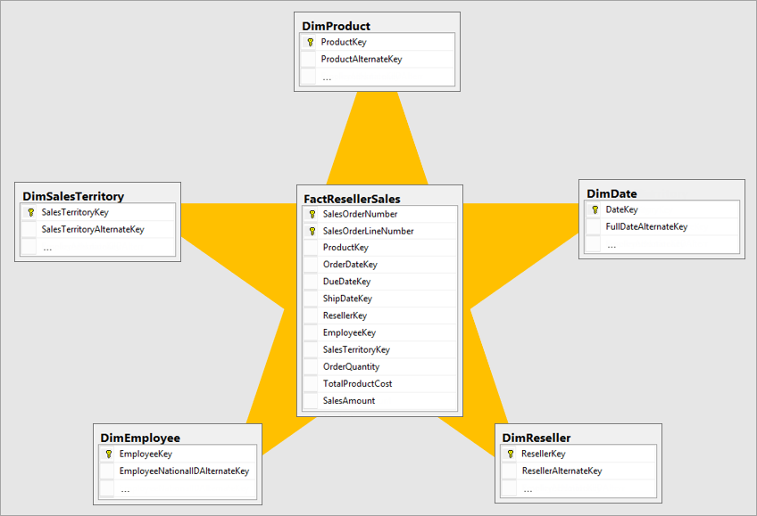
Power BI
Data modeling
Why Star Schema?

Slide 37

Power BI
Data modeling
Why Start Schema?

Slide 38
Power BI
Data modeling
Dough mindset

Slide 39
Power BI
Data modeling
To answer Ws
When? --- Date dimension
Where? --- Location dimension
Who? --- Supplier, Customer, Employee dimension
What? --- Product Category dimension
Why? --- ?

Slide 40
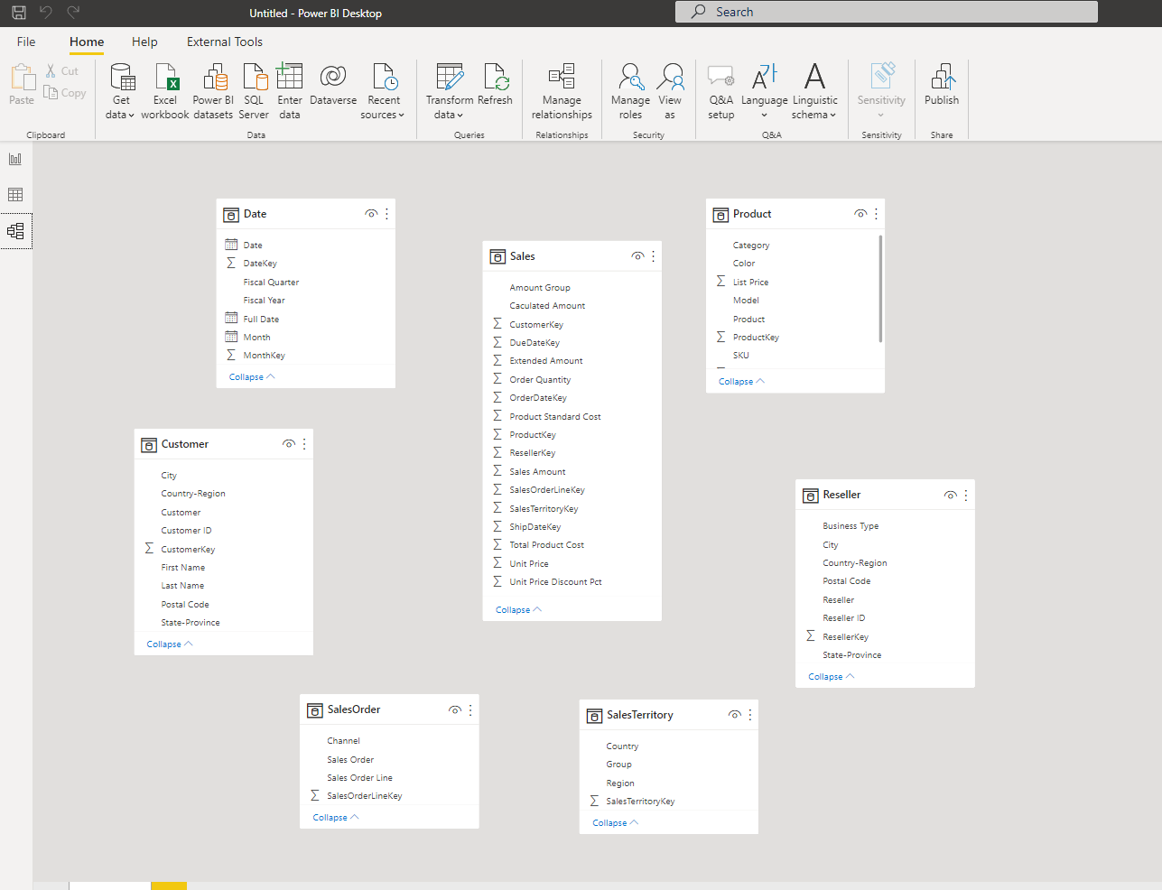
Power BI
Data modeling
Why Start Schema?
Go to “model” view
Use Sales table as the center of the star
Dimension tables as surrounding tables

Slide 41
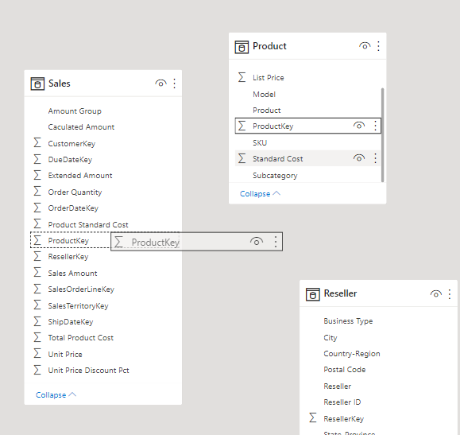
Power BI
Data modeling
Creating relationship
Left click on “ProductKey” in “Product” table and hold it and drag it onto “ProductKey” in “Sales” table

Slide 42
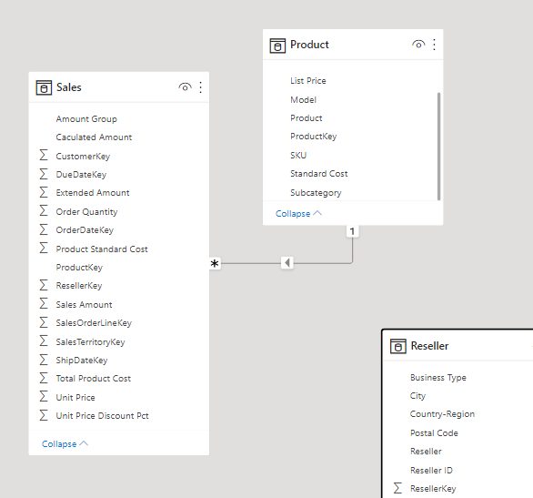
Power BI
Data modeling
Creating relationship
You have created a one-to-many relationship

Slide 43
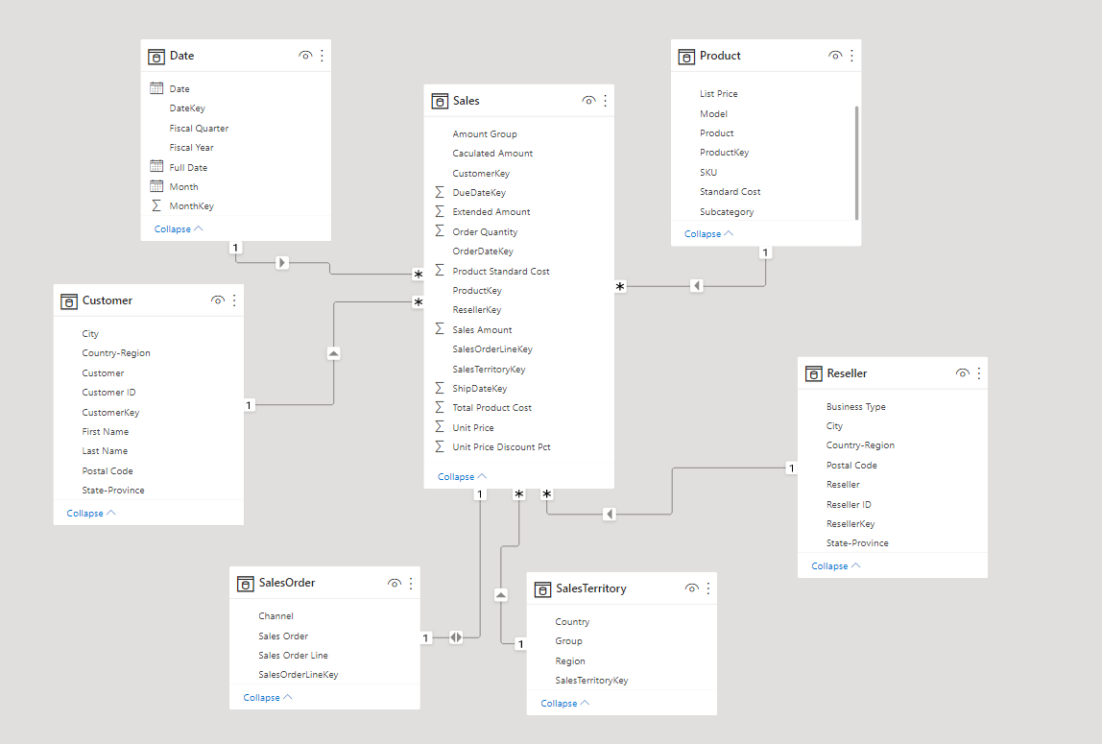
Power BI
Data modeling
Creating relationship
Do this for all the dimension tables

Slide 44
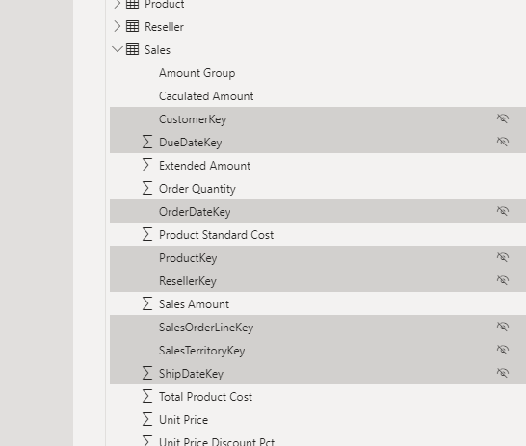
Power BI
Data modeling
Creating relationship
Hide all the key columns by click on the eye icon.

Slide 45
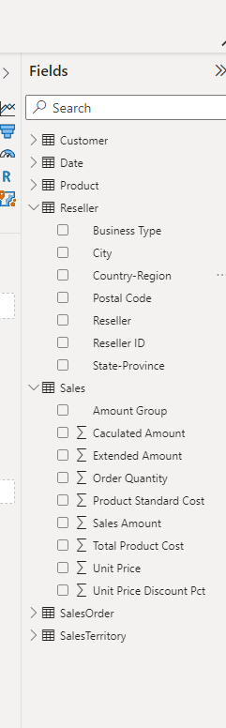
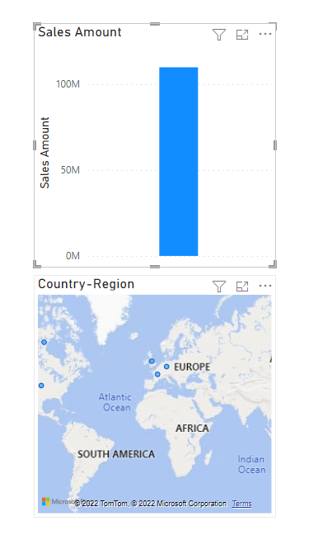
Power BI
Data modeling
Creating relationship
Drag “Country-Region” and “Sales Amount” to the design board

Slide 46
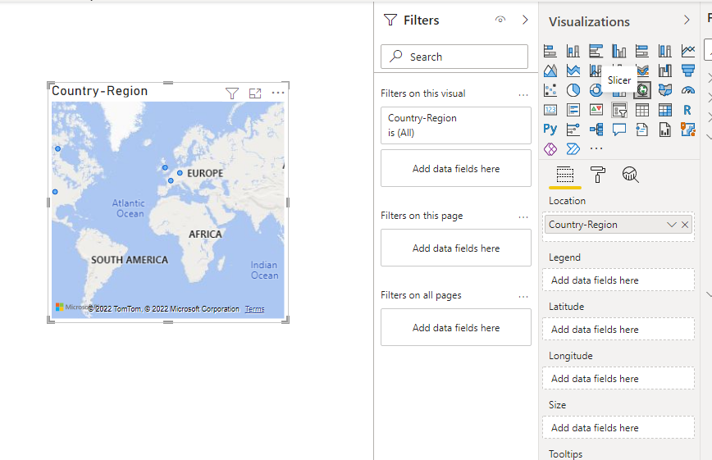
Power BI
Data modeling
Creating relationship
Click on “Country-Region” on the design board
Click on “Slicer” on the “Visualizations”

Slide 47
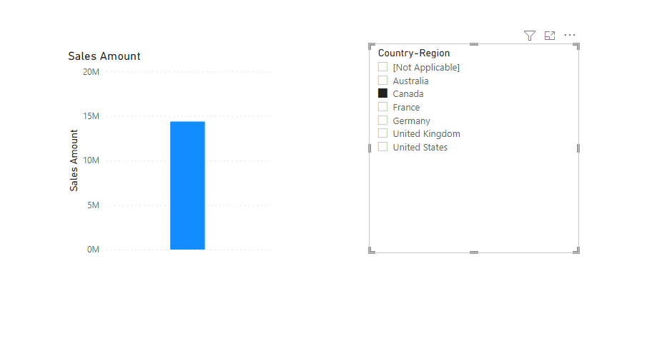
Power BI
Data modeling
Creating relationship
Use “Country-Region” as “Slicer” to filter “Sales Amount”

Slide 48
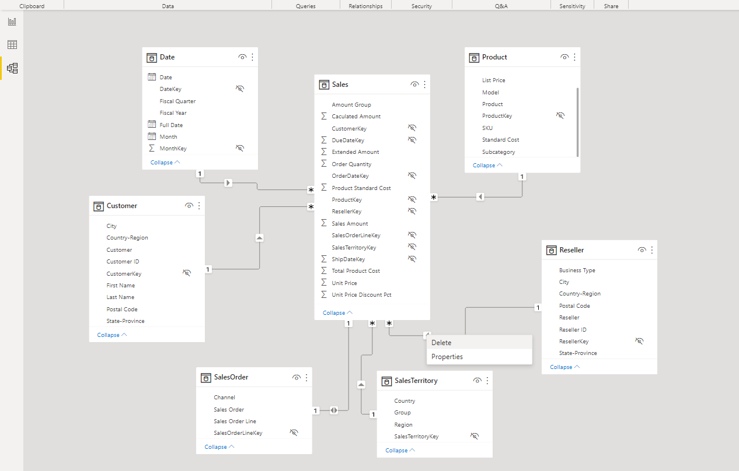
Power BI
Data modeling
Creating relationship
Go to “Model” view
Right click the link between “Reseller” and “Sales” and delete the link

Slide 49
Power BI
Data modeling
Creating relationship
Go back to the design board
Use “Country-Region” as “Slicer” to filter “Sales Amount”
You won’t be able to filter anymore

Slide 50
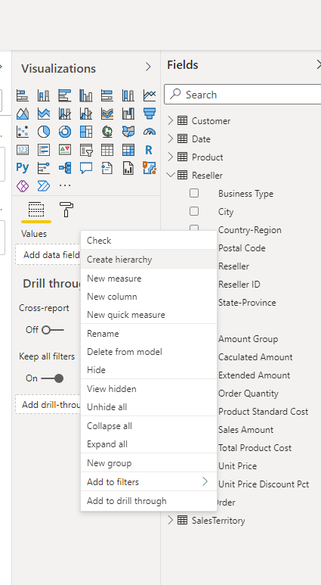
Power BI
Data modeling
Create hierarchies
Go back to the design board
Right click “Country-Region” from table “Reseller” and then select “Create hierarchy”

Slide 51
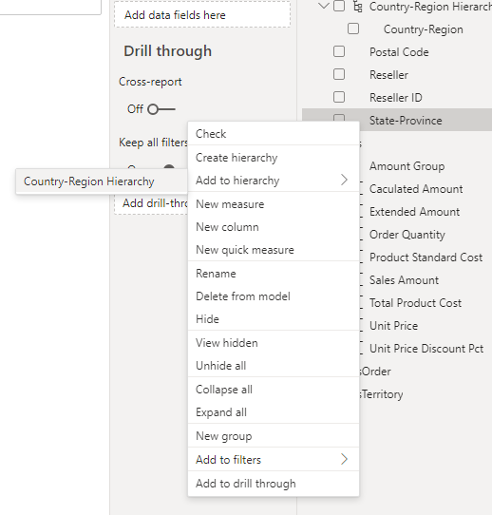
Power BI
Data modeling
Create hierarchies
Right click “State-Province” from table “Reseller” and then select “Add to hierarchy” then “ Country-Region Hierarchy”

Slide 52
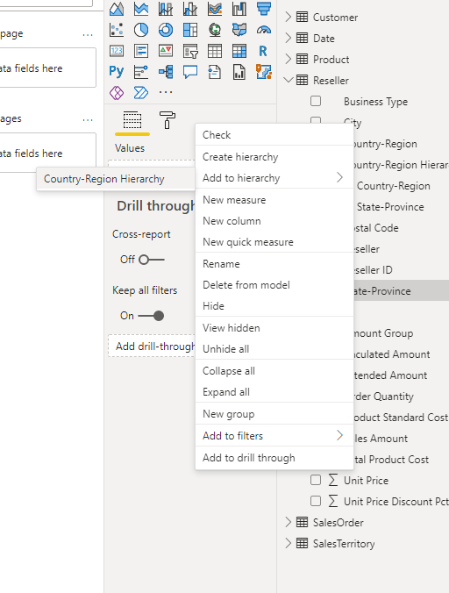
Power BI
Data modeling
Create hierarchies
Right click “City” from table “Reseller” and then select “Add to hierarchy” then “ Country-Region Hierarchy”

Slide 53
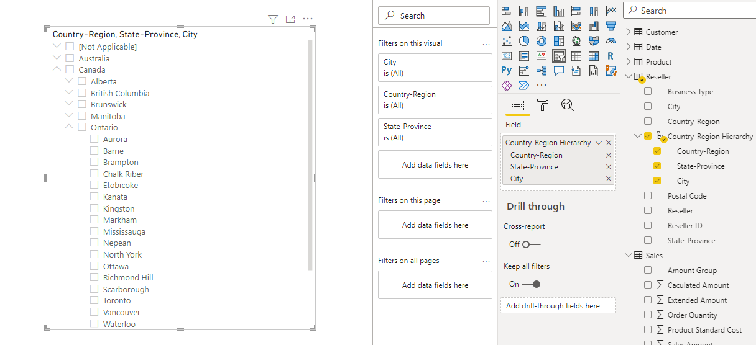
Power BI
Data modeling
Create hierarchies
Use it as a “Slicer”
You can see now you can use it as filter on different levels( country, province, city)

Slide 54
Power BI
Data modeling
Create hierarchies
Practice: do the same for the date dimension

Slide 55
Power BI
DAX
Why DAX?
Dough mindset

Slide 56
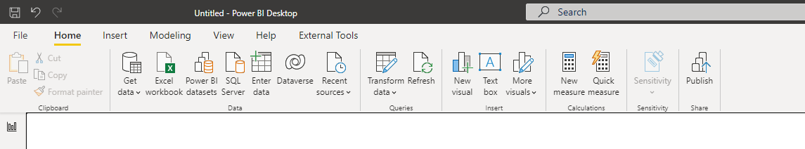
Power BI
DAX
Why DAX?
Go to “Report” view
Click “New measure”

Slide 57
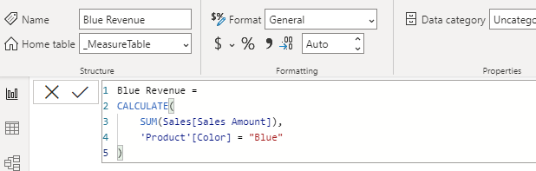
Power BI
DAX
Why DAX?
Type “Blue Revenue =
CALCULATE(
SUM(Sales[Sales Amount]),
'Product'[Color] = "Blue"
)”
Press Enter

Slide 58
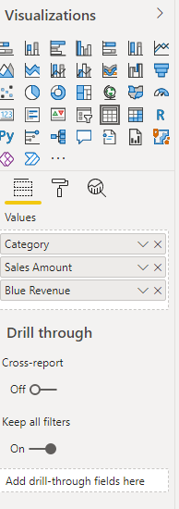

Power BI
DAX
Why DAX?
Drag “ Category”, “Sales Amount” and “Blue Revenue” into the “Value” filed

Slide 59



Power BI
DAX
Why DAX?
Drag “Color” and “Country-Region” from table “Product” onto the design/report board and use it as a “Slicer”

Slide 60
Power BI
DAX
Calculate and ALL
ALL color Revenue =
CALCULATE(
SUM(Sales[Sales Amount]),
all('Product'[Color])
)
ALL Revenue =
CALCULATE(
SUM(Sales[Sales Amount]),
all(Sales)
)
ALLexcept color Revenue =
CALCULATE(
SUM(Sales[Sales Amount]),
allexcept('Product','Product'[Color])
)

Slide 61
Power BI
DAX
Calculate and FILTER
Revenue Red =
CALCULATE(
SUM(Sales[Sales Amount]),
FILTER(
'Product',
'Product'[Color] = "Red"
)
)
Revenue High Margin Products =
CALCULATE(
sum(Sales[Sales Amount]),
FILTER(
'Product',
'Product'[List Price] > 'Product'[Standard Cost] * 2
)
)

Slide 62
Power BI
DAX
SUM and SUMX
Revenue_sum = SUM(Sales[Sales Amount])
Revenue_sumx =
SUMX(
Sales,
Sales[Sales Amount]
)

Slide 63
Power BI
DAX
USERRELATIONSHIP
Sales Amount by Due Date = CALCULATE(SUM(Sales[Sales Amount]), USERELATIONSHIP(Sales[DueDateKey],'Date'[DateKey]))

Slide 64

Power BI
Visual
Visual 1: Add a title

Slide 65

Power BI
Visual
Visual 1: Add a title
Go to “Report” view

Slide 66

Power BI
Visual
Visual 1: Add a title
Click Text box

Slide 67
Power BI
Visual
Visual 1: Add a title
Click Text box

Slide 68


Power BI
Visual
Visual 2: Sales Amount by Date
Drag “Sales Amount” to the design board

Slide 69


Power BI
Visual
Visual 2: Sales Amount by Date
Drag “Month” from “Date” table to the Axis field

Slide 70

Power BI
Visual
Visual 2: Sales Amount by Date
Remove “Year” and “Quarter”

Slide 71

Power BI
Visual
Visual 2: Sales Amount by Date
Click on the chart and then click “Area chart”

Slide 72

Power BI
Visual
Visual 2: Sales Amount by Date

Slide 73
Power BI
Visual
Visual 2: Sales Amount by Date
Click on the chart and then click “Area chart”

Slide 74

Power BI
Visual
Visual 2: Sales Amount by Date
Click on the “Format”
Change the color

Slide 75

Power BI
Visual
Visual 3: Order Quantity by Reseller Country
drag the Country-Region field from the Reseller table to a blank area on your report canvas
Drag the Order Quantity field from the Sales table and drop it on the map

Slide 76


Power BI
Visual
Visual 4: Sales Amount by Product Category and Reseller Business type
Select “Matrix”
In the Fields pane, select Sales Amount from Sales, Product Category from Product, and Business Type from Reseller.

Slide 77


Power BI
Visual
Visual 4: Sales Amount by Product Category and Reseller Business type
In the Formatting pane for the matrix, open the Conditional formatting section and turn on Data bars. Select Advanced controls and set a lighter color for the positive bar. Select OK.
Increase the width of the Sales Amount column so it covers the whole area by dragging the matrix

Slide 78



Power BI
Visual
Visual 5: Fiscal calendar slicer
In the Fields pane, select the Date hierarchy from the Date table and drag it to the blank area on the left of the canvas.
In the Visualizations pane, choose Slicer.
In the Fields section of the Visualizations pane, remove Quarter and Date so only Year and Month are left.

Slide 79

Power BI
Visual
FINAL REPORT

Slide 80
Power BI
Visual
FINAL REPORT
Which day had the most sales in February 2019? February 25, with a sales amount of $253,915.47.
Which country is the company seeing the most success in? In the United States, with an order quantity of 132,748.
Which product category and reseller business types should the company continue to invest in? The company should continue to invest in the Bikes category and the Value Added Reseller and Warehouse reseller businesses.

Slide 81

学习的目的-准备简历和面试
Transform interview into a presentation whenever possible
把面试变成一个演讲简报

Slide 82
答案 demo – Financial analysis
We are small/mid-sized company so sometimes we need to wear multiple hats
For example we sometimes get ad hoc(临时的任务) tasks like data entry and bookkeeping.
I had the opportunities to get involved in a data analysis project where we needed to prepare income statement and financial analysis
Can I share my screen? Here is an example…
适合各种背景的同学：
自雇/自己经营生意
Office Administrator/Accounting
Any small/mid-sized business

Slide 83
Data flow
Accounting Software
MS Access/SQL SERVER/excel
POWER BI/Tableau

Slide 84

Financial analysis 项目
Data in Access DB

Slide 85

Financial analysis 项目
Data in POWER BI

Slide 86

Financial analysis 项目

Slide 87

Financial analysis 项目

Slide 88

Financial analysis 项目

Slide 89
Income Statement
An income statement is one of the three (along with balance sheet and statement of cash flows) major financial statements that reports a company's financial performance over a specific accounting period.
Net Income = (Total Revenue + Gains) – (Total Expenses + Losses)
An income statement provides valuable insights into a company’s operations, the efficiency of its management, under-performing sectors and its performance relative to industry peers.

Slide 90

Income Statement

Slide 91
Balance Sheet
A balance sheet is a financial statement that reports a company's assets, liabilities, and shareholder equity.
The balance sheet is one of the three core financial statements that are used to evaluate a business.
It provides a snapshot of a company's finances (what it owns and owes) as of the date of publication.
The balance sheet adheres to an equation that equates assets with the sum of liabilities and shareholder equity.
Fundamental analysts use balance sheets to calculate financial ratios.

Slide 92

Balance Sheet

